Slide 1
Week 5 lesson
Bonding and the periodic table

Slide 2
chemical bonds are caused by electrostatic attractions that arise because of the sharing or transfer of electrons between participating atoms; the valency is a measure of the bonding capacity of an atom
Atoms tend to form chemical bonds to obtain a filled valence shell and become chemically stable.
Chemical bonds are due to the electrostatic force of attraction between positive and negative charges in participating atoms.

Slide 3
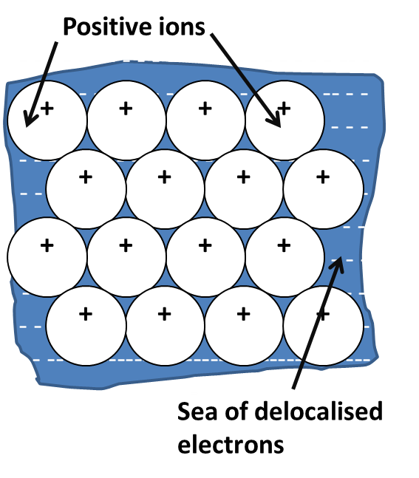
the type of bonding within ionic, metallic and covalent substances explains their physical properties, including melting and boiling points, conductivity of both electricity and heat and hardness
There are three types of chemical bonds
Metallic bond: The electrostatic force of attraction that holds metal atoms together; acts between negatively charged delocalised valence electrons and positively charged metal cations.

Slide 4
Ionic bonds: Involve the electrostatic force of attraction between positively charged cations and negatively charged anions; results in an ionic compound with a three-dimensional lattice structure.
Covalent bonds: This involve electrostatic attraction between shared negatively charged electrons and positively charged nuclei; results in a molecule or covalent lattice.

Slide 5
Valency is the combining power of an atom and is equal to the number of hydrogen atoms that atom could combine with or dis[p[lace from a compound. Hydrogen has valency of 1.
the metallic bonding model can be used to explain the properties of metals, including malleability, thermal conductivity, generally high melting point and electrical conductivity; covalent bonding can be modelled as the sharing of pairs of electrons resulting in electrostatic forces of attraction between the shared electrons and the nuclei of adjacent atoms

Slide 6
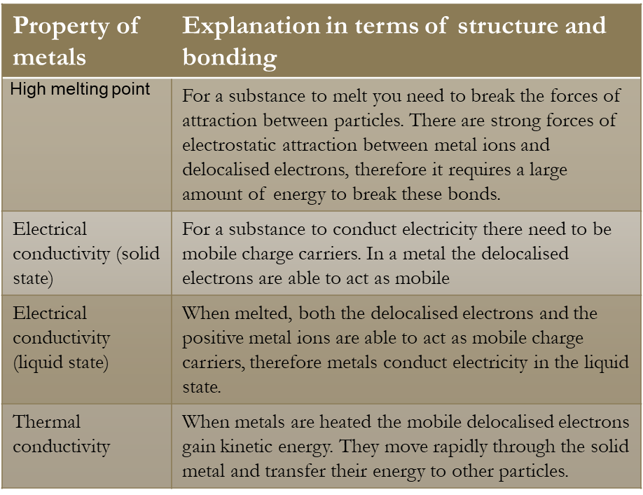
metals, bonding & properties

Slide 7
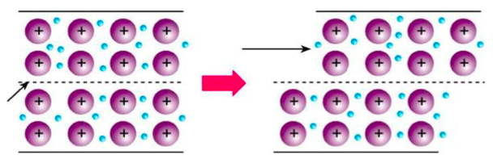
Malleability & Ductility Lustre Hardness Density | The force of attraction between metal ions and delocalised electrons in non-directional. When a force is applied a row of ions is able to move into a new position without breaking metallic bonds. The combination of the reflection of incident rays and the close packing of the metal cations prevent light passing through the metal. So, metals are opaque. ( see diagram- C3.7, Page: 166) When a substance is scratched, particles in the surface layers are shifted out of position. So the more strongly the particles are held in position, the harder it is to scratch. Some metals are soft( e.g. gold) easy to scratch while others are hard to scratch suggests that bonding forces in metals vary in strength.. Density depends on how closely the ions are packed, volume of each ion, and the mass of each ion. Metals with higher atomic numbers and more filled electron shells will have greater masses and volumes. Elements with lower atomic numbers have low density, while elements with higher at. no. have higher density.

Slide 8
Metallic bonds are non-directional because electrons are free to move between cations.

Slide 9
Complete questions: Set :10 Metallic substances
P:54 Essential chemistry

Slide 10
Ionic compounds, properties and bonding
the ionic bonding model can be used to explain the properties of ionic compounds, including high melting point, brittleness and non-conductivity in the solid state; the ability of ionic compounds to conduct electricity when molten or in aqueous solution can be explained by the breaking of the bonds in the lattice to give mobile ions
Physical properties of an ionic compound is different from the properties of individual elements which makes up that compound.
When atoms lose or gain electrons to attain a full outer shell, they form a charged particle called an ion.
Positively charged ions are called as cations, and negatively charged ions are called as anions.

Slide 11
SODIUM CHLORIDE
Na
Cl
SODIUM ATOM
2,8,1
CHLORINE ATOM
2,8,7

Slide 12
SODIUM CHLORIDE
+
Na
Cl
SODIUM ION
2,8
CHLORIDE ION
2,8,8

Slide 13
SODIUM CHLORIDE
+
Na
Cl
SODIUM ION
2,8
CHLORIDE ION
2,8,8
Na Na⁺ + e¯
2,8,1 2,8
ELECTRON TRANSFERRED
Cl + e¯ Cl¯
2,8,7 2,8,8

Slide 14
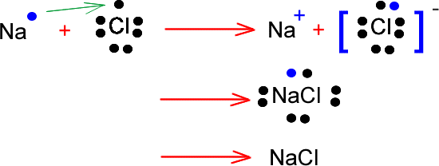
Lewis dot diagrams or electron dot formula

Slide 15
ionic bonding can be modelled as a regular arrangement of positively and negatively charged ions in a crystalline lattice with electrostatic forces of attraction between oppositely charged ions
Ionic compounds have a crystalline structure in which the positive and negative ions are arranged in an orderly fashion with every positive ion being surrounded by negative ions and every negative ion is being surrounded by positive ions.
There are no separate units of NaCl, jut a large array of cations and anions held together by ionic bonds.
Formulas of ionic compounds are always empirical formulas. There are no discrete molecules in an ionic compound, the formula gives the ratio of ions rather than actual number of ions.

Slide 16
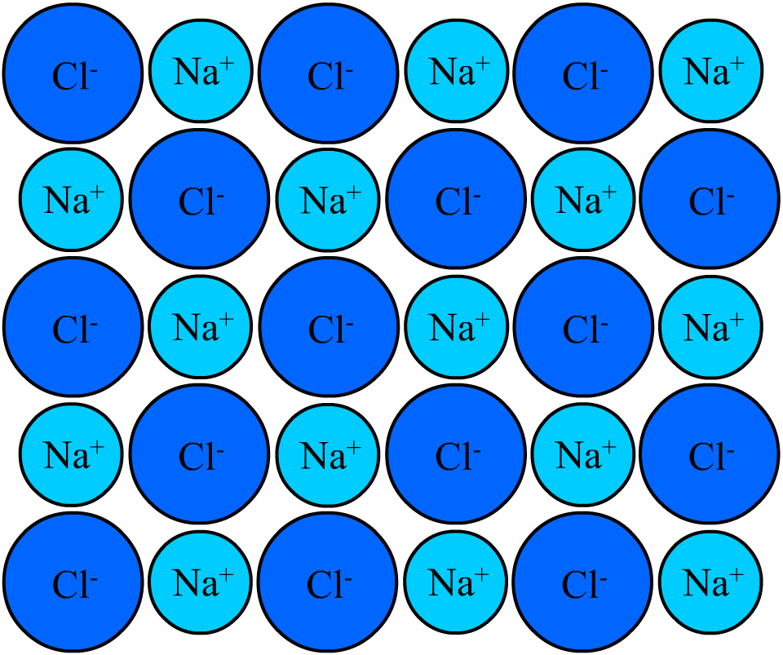
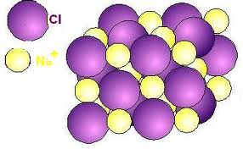

Slide 17
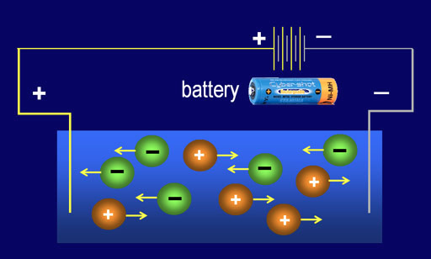

Properties of ionic compounds | Explanation
High melting point | A large amount of energy needed to overcome strong electrostatic attractions between ions which are present in the fixed position in the lattice.
Electrical conductivity | do not conduct when solid - ions are held strongly in the lattice. Conduct when molten or in aqueous solution - the ions become mobile and conduction takes place.
Strength: Hard but brittle | Ions are held rigidly in place in the lattice but the application of stress brings ions of the same charge close together , repulsion causes the crystal to shatter.
Sloubility | Most soluble in water. Water is a polar solvent, ions are attracted to water molecules and move out of position, but they are insoluble in non-polar solvents.
Giant lattice of repeating ions | Electrostatic attraction between positive and negative charges causes ions of of opposite charge to surround each other.

Slide 18
The non-directional bonding holds the ions in place so prevents ionic crystals from being malleable like metals, so ionic crystals will shatter when hit with a strong force.
Question set: 11 – Page: 56 EC

Slide 19
Properties of covalent compounds and covalent bonding
molecular structural formulae (condensed or showing bonds) can be used to show the arrangement of atoms and bonding in covalent molecular substances
the properties of covalent molecular substances, including low melting point, can be explained by their structure and the weak intermolecular forces between molecules; their non-conductivity in the solid and liquid/molten states can be explained by the absence of mobile charged particles in their molecular structure
A covalent molecular substance is composed of discrete molecules in which the atoms are held together by covalent bonding.
A covalent network substance is a three –dimensional network of covalently bonded atoms.

Slide 20
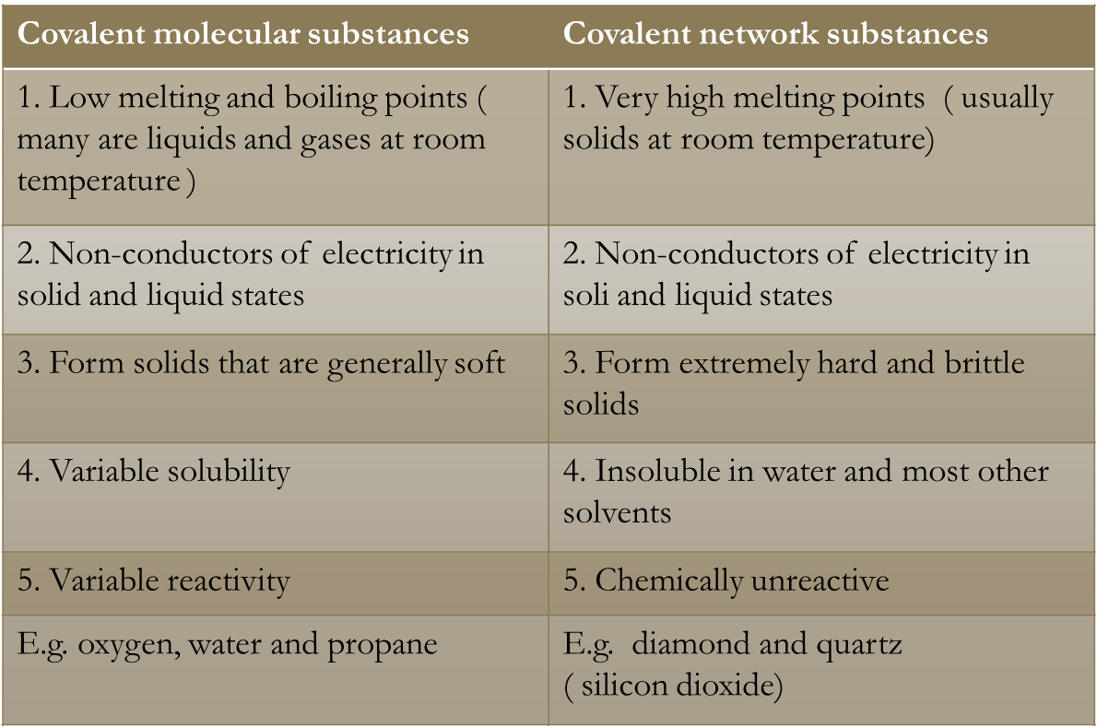

Slide 21
Covalent bonding
Covalent bonding is the electrostatic forces of attraction between electrons and the nucleus of more than one atom. Covalent substances may be molecules or networks.
Covalent bonding is also referred to as directional bonding because there is a direct line between the bonded particles.
E.g. Hydrogen molecule

Slide 22
Representing covalent bonds
A covalent bond can be represented in a number of different ways. An electron dot formula can be used to show shared and unshared electrons. The pairs of unshared valence electrons are called non-bonding pairs or lone pairs.
Another representation used is to denote each pair of shared electrons by a dash. One dash means one shared ( bonding pair) of electrons or one covalent bond.

Slide 23
Covalent bonds and the periodic table
Covalent bonding occurs when both of the elements forming the substance need to gain electrons to attain noble gas configuration. E.g. H_{2,} H₂O and CO₂
Hydrogen, metalloids and non-metals, except the noble gases, tend to form covalent bonds.

Slide 24
HYDROGEN
H
H
Hydrogen atom needs one electron to complete its outer shell
Another hydrogen atom also needs one electron to complete its outer shell
WAYS TO REPRESENT THE MOLECULE
H H
H H

Slide 25
HYDROGEN CHLORIDE
Cl
H
atoms share a pair of electrons to form a single covalent bond
Chlorine atom needs one electron to complete its outer shell
Hydrogen atom also needs one electron to complete its outer shell
WAYS TO REPRESENT THE MOLECULE
H Cl
H Cl

Slide 26
METHANE
H
WAYS TO REPRESENT
THE MOLECULE
Each hydrogen atom needs 1 electron to complete its outer shell
H
H
C
H C H
H
H
H
H
A carbon atom needs 4 electrons to complete its outer shell
Carbon shares all 4 of its electrons to form 4 single covalent bonds
H C H
H

Slide 27
AMMONIA
WAYS TO REPRESENT
THE MOLECULE
H
N
Each hydrogen atom needs one electron to complete its outer shell
H N H
H
H
H
H N H
Nitrogen can only share 3 of its 5 electrons otherwise it will exceed the maximum of 8
A LONE PAIR REMAINS
Nitrogen atom needs 3 electrons to complete its outer shell
H

Slide 28
WATER
WAYS TO REPRESENT
THE MOLECULE
Each hydrogen atom needs one electron to complete its outer shell
H
O
H O
H
H
Oxygen atom needs 2 electrons to complete its outer shell
Oxygen can only share 2 of its 6 electrons otherwise it will exceed the maximum of 8
2 LONE PAIRS REMAIN
H O
H

Slide 29
Multiple covalent bonds
Sometimes when atoms come together, they share more than one pair of electrons when this occurs, a multiple covalent bond will be formed.

Slide 30
OXYGEN
O
O
O
O
each atom needs two electrons to complete its outer shell
each oxygen shares 2 of its electrons to form a
DOUBLE COVALENT BOND
O O

Slide 31
Carbon, in group 14, has a valency of 4 so can form 4 covalent bonds. It cannot form a quadruple covalent bond because this type of bond cannot exist. This cannot happen because the repulsive forces between the negative electrons becomes greater than the attractive forces between the electrons and the nuclei, preventing a fourth pair of electrons in the bond.

Slide 32
Covalent network substances
elemental carbon exists as a range of allotropes, including graphite, diamond and fullerenes, with significantly different structures and physical properties
Carbon and silicon both have a valency of four. So, they can make 4 covalent bonds. As a result, they can form three-dimensional networks of covalently bonded atoms. The three- dimensional nature of the network means the atoms are held rigidly in position by very strong bonds.
Elemental carbon exists in different forms or allotropes, including graphite, diamond and fullerenes.

Slide 33
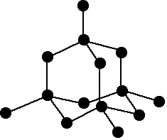
the properties of covalent network substances, including high melting point, hardness and electrical conductivity, are explained by modelling covalent networks as three-dimensional structures that comprise covalently bonded atoms
Carbon in the form of diamond is an example of a covalent network. Each carbon atom is covalently bonded to four other carbon atoms in an orderly pattern that continues throughout the whole structure to make a giant crystalline lattice. The bonding electrons are tightly bound and highly localised.

Slide 34
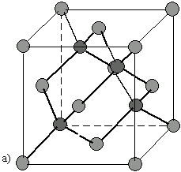
Silicon and carbon covalently bond to form the crystalline compound silicon carbide( SiC). The compound has a rigid diamond –like structure with alternating silicon and carbon atoms. Silicon carbide is also called as carborundum.

Slide 35
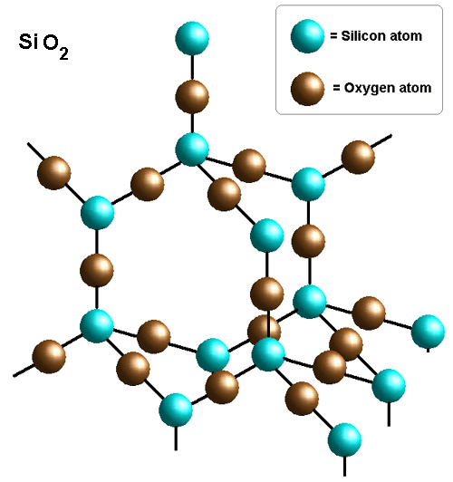
In SiO₂ each silicon atom is bonded to four oxygen atoms and each oxygen atom is bonded to two silicon atoms. This pattern extends throughout the entire crystalline lattice.

Slide 36
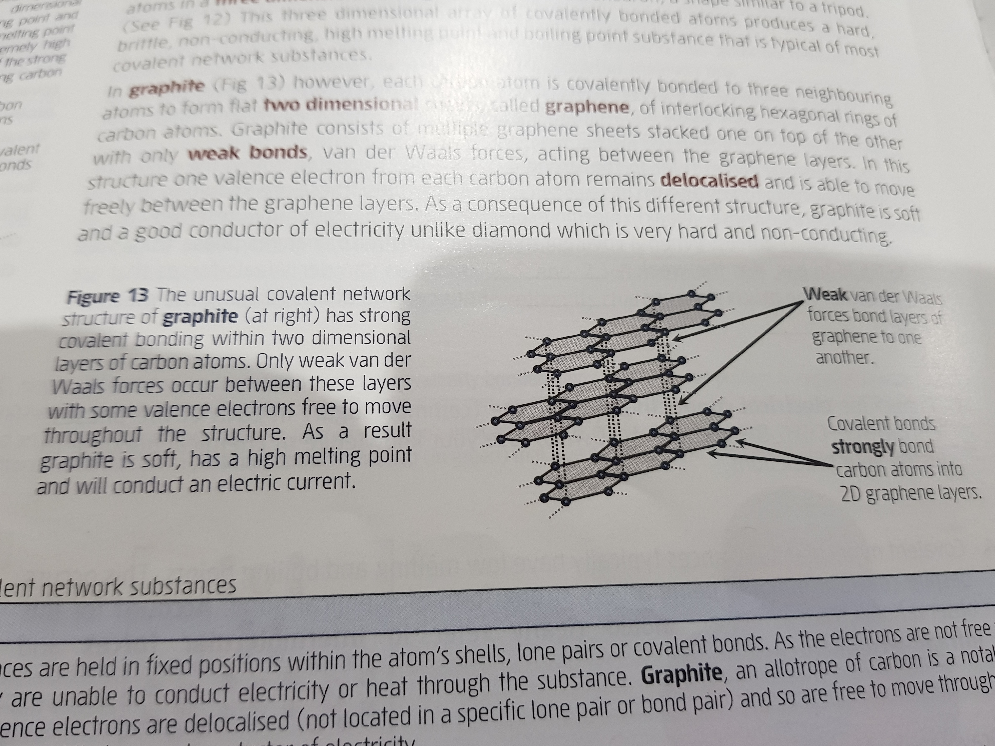
Graphite
In Graphite each carbon atom is covalently bonded to three neighboring atoms to form flat two dimensional sheets, called graphene, of interlocking hexagonal rings of carbon atoms.

Slide 37
Graphite consists of multiple graphene sheets stacked one on top of the other with only weak bonds, van der Waals forces, acting between the graphene layers.
One valence electron from each carbon atom remains delocalised and is able to move freely between the graphene layers. As a consequence, graphite is soft and a good conductor of electricity unlike diamond which is very hard and non-conducting.

Slide 38
Questions
Complete EC unit 1&2 Q’s 1, 2,4, 5( a, n, r, h and l) and 6 from set 12.

Slide 39
Hydrocarbons
The vast majority of compounds known to chemists are carbon compounds and there is a branch of chemistry, organic chemistry for carbon-based compounds.
Hydrocarbons are compounds made up of only hydrogen and carbon. The simplest group of hydrocarbons are the alkanes.

Slide 40
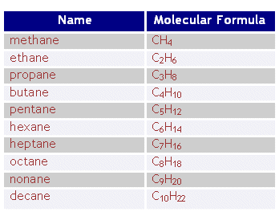
Alkanes

Slide 41
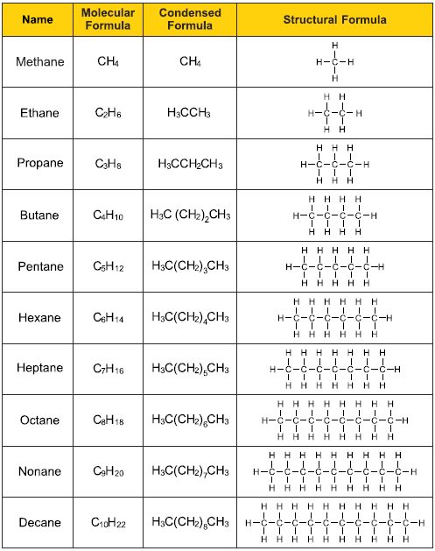

Slide 42
The first ten alkanes are called straight-chain alkanes because the carbon atoms are joined in one continuous string. The chain is not really straight but more like a zig-zag because of the way carbon bonds are arranged tetrahedrally.
Alkanes are also classified as saturated compounds. This means they contain only carbon-carbon single bonds.
The general formula for alkanes can be expressed as C_{n}H_{2n+2} where ‘n’ is a whole number.

Slide 43
Naming alkanes
The name of a carbon compound consists of a stem, which gives the length of the carbon chain, and an ending, which denotes the family of hydrocarbons the compound belongs to.
The stems of first ten members of the series are: meth-C, eth- C₂, prop- C₃, but-C₄, pent- C₅, hex-C₆, hept- C₇, oct-C₈, non-C₉, dec- C₁₀
Alkane family have names ending in -ane.

Slide 44
Rules for naming branched alkanes
The rules for naming branched alkanes are:
End of name indicates the hydrocarbon family the compound belongs. Alkanes always end in – ane.
Determine the longest continuous carbon chain and use the name of the corresponding alkane. This chain represents the parent structure.
Other atoms or groups of atoms attached to the main chain are called as sustituents and they form ‘branches’.

Slide 45

If the substituent is a carbon group, then it is called an alkyl group. The alkyl group is named according to carbon atoms and given the ending -yl.
E.g CH₃- would be called as methyl.
F- fluoro, Cl- chloro, NO₂- nitro
What is the name of the following compound?

Slide 46
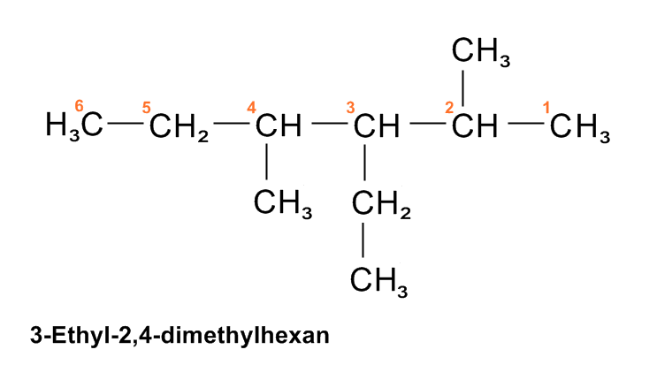
When there is more than one substituent of the same type, use the prefixes di, tri, tetra etc. ( separate numbers by a comma)

Slide 47
Drawing structural formulas of branched alkanes
1. Use the main name to draw the longest carbon chain and number the carbon chain.
2. Identify and add the substituent group to the parent chain.
3. Add the hydrogen atoms to complete the structure.

Slide 48
Properties of alkanes
Alkanes are covalent molecular substances.
Physical properties of alkanes
Prpperty | Alkanes
Appearance | Colouless and odourless
Melting & boiling point | Low MP/ BP, which increase as the molecular mass increase. The first 4 being gases at room temperature.
Electrical conductivity | Non-conductors
Hardness | Solid alkane s are soft
Malleability | Solid alkanes are malleable
Solubility | Insoluble in water but soluble in some other solvents

Slide 49
Chemical reactivity
Alkanes do not react with most substances.
The do two important reactions.
1. Combustion: When ignited in a plentiful supply of oxygen, they react readily and produce water, CO₂ and a large quantity of heat. This makes alkanes important as fuel.
C₃H₈(g) + 5O₂ ➔ 3CO₂ (g) + 4H₂O (g)
2C₈H₁₈ (g) + 25 CO₂ (g) + 18 H₂O (g)

Slide 50
2. Substitution: In a substitution reaction, a hydrogen atom is replaced with an atom of another element. The reaction usually only occurs with chlorine or bromine and will not occur unless sufficient amount of energy is supplied.
E.g. In the presence of UV light, following reactions will occur.
CH₄(g) + Cl₂ (g) ➔ CH₃Cl)g) + HCl (g)
Chloromathane
C₆H₁₄(g) + Br₂(soln) ➔ C₆H₁₃Br (soln) + HBr (soln)
Bromohexane

Slide 51
Sustitution reactions can continue until all the hydrogen atoms in the compound have been replaced by halogen, so in the case of methane the final product would be CCl₄ , which is tetrachloromethane.

Slide 52
Alkenes
The alkene family contains hydrocarbons in which one pair of carbon atoms are joined by a double bond and all the other carbon atoms are joined by single bonds.
All compounds that are in the alkene family have names have names ending in –ene.
The simplest alkene is ethene C₂H₄, next one is propene, C₃H₆.
Alkenes general formula is C_{n}H_{2n}

Slide 53
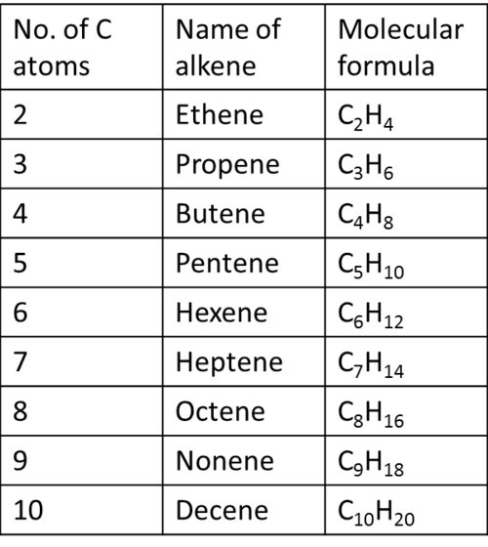

Slide 54
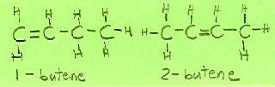
Naming alkenes
Naming alkene is not quite straightforward as naming alkanes. The reason is double bond can occupy a number of positions. This does not change molecular formula, but does change the structural formula.
Compounds have the same molecular formula but different structural formula are called structural isomers.

Slide 55
Rules for naming alkenes
Take the usual stem name( e.g. eth- and but-)which indicates the number of carbon atoms in the chain, and add the ending –ene.
Determine the location of the double bond by numbering the carbon atoms from the end of the chain closest to the double bond.
Show the location of the double bond by putting in front of the name the number of the carbon at which the double bond starts followed by a hyphen(-).

Slide 56
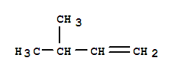
Naming branched alkenes
1. Identify the main (parent) chain by selecting the longest continuous carbon chain containing carbon-carbon double bond. The name corresponding to the alkane stem with the ending –ene forms the main name.
Branched alkenes are named similar to branched alkanes, except the lowest number is assigned to the double bond and not the substituent group.
3-methyl-1-butene

Slide 57
Properties of alkenes
At room temperature, the first 3 ( C₂- C₄) are gases, (C₅- C₁₅) are liquids and the remainder are solids. All are insoluble in water but dissolve in other solvents like alkanes.

Slide 58
Chemical reactivity
Alkenes undergo combustion in a plentiful supply of oxygen to produce CO₂ and water.
C ₄H₈ (g) + 6O₂ ➔ 4CO₂(g) + 4H₂O
Alkenes undergo large number of addition raction.
E.g. CH₂= CH₂ (g) + H₂ (g) ➔ C H₃CH₃(g)

Slide 59
Reaction with halogen
When a halogen such as chlorine or bromine reacts with an alkene, halogen atoms add across the double bond.
E.g. CH₃- CH= CH₂ (g) + Cl₂ (g)➔CH₃- CHCl- CH₂Cl   
Reaction with water
Water, in the presence of a sulfuric acid catalyst, adds an H and OH across the double bond to produce an organic compound called an alcohol.

Slide 60
E.g. CH₂= CH₂(g) ₊ H₂O(g) ➔CH₃-CH₂OH(l)
Polymerisation
In the presence of a suitable catalyst and reaction conditions, ethene molecules will react with themselves to form long chains. This type of reaction is called addition polymerisation.

Slide 61
Important points about addition reactions
1. When a symmetrical reagent, for example H₂ or Cl₂, is added, the product of the reaction has the same group added to each carbon.
E.g. CH₂= CH₂ (g) + H₂ (g) ➔ C H3-CH3(g)
2. When an asymmetrical reagent, e.g. H₂O or HBr is added to a symmetrical alkene, there is only one possible product.
E.g. CH₂= CH₂(g) ₊ H₂O(g) ➔ CH₃-CH₂OH(l)

Slide 62
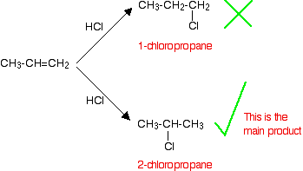
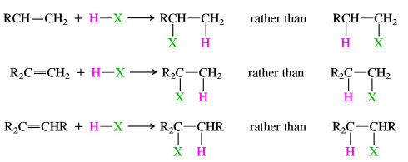
3. When an asymmetrical reagent, e.g. H₂O or HBr, is added to an asymmetrical alkene, there are two possible products. In reality one product predominates because of Markovnikoff’s rule, which states that the hydrogen atom will add across the double bond to the carbon that already has the greater number of hydrogen atoms.

Slide 63
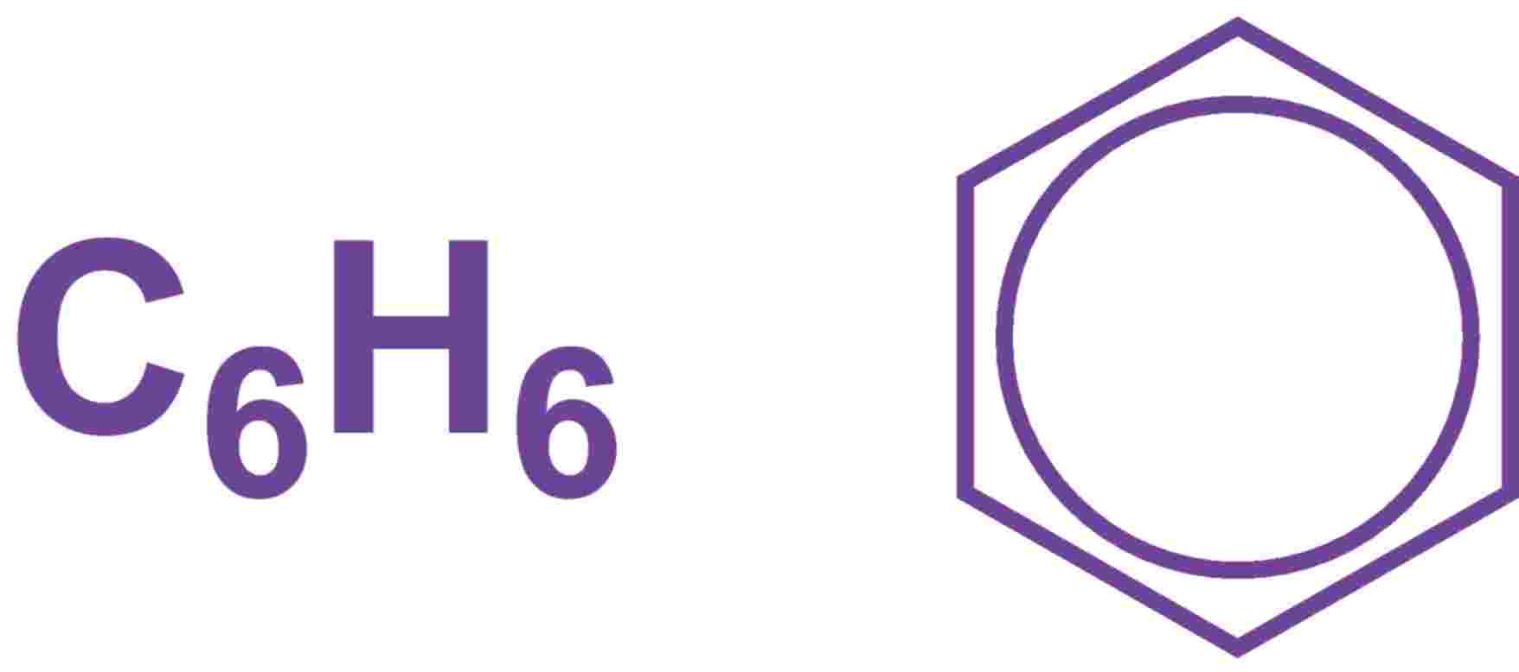
Benzene
It is the simplest member of the family of aromatic hydrocarbons. This group originally got their name because many of them have a strong aroma (smell).
Benzene is a colourless liquid with molecular formula of C₆H₆, so it must be an unsaturated molecule. The structure is a six-sided flat ring with all bond angles of 120⁰. The carbon atoms are joined in a regular hexagon with one hydrogen atom attached to each carbon

Slide 64
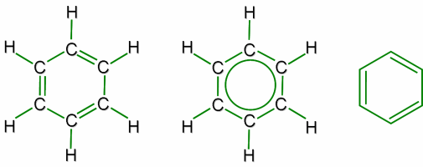

Slide 65
Benzene contained alternating single and double bonds so should undergo addition reactions similar to the alkenes and cycloalkenes. However, this rarely happens. The reactions of benzene are completely different from those of other double-bonded hydrocarbons.
Investigation of the benzene ring found that all the carbon-carbon bonds had the same bond length, which is somewhere between a single bond and a double bond. This can be explained if the electrons of the double bond are spread out around the ring of carbon atoms, making a cloud of delocalised electrons above and below the ring. This is similar to delocalisation of electrons found in the structure of metals.

Slide 66
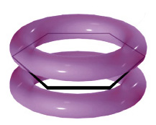
Bonding in benzene

Slide 67
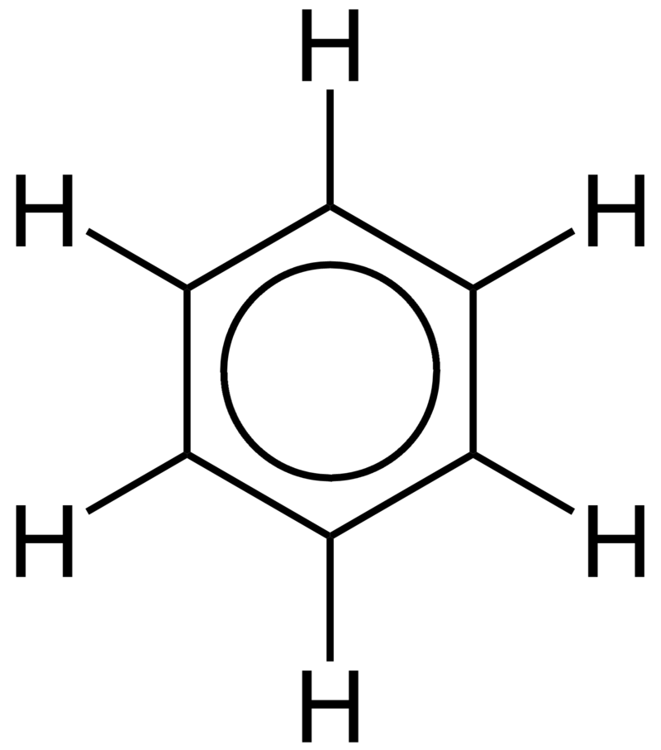
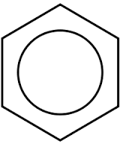
In chemical structures, the benzene ring is usually represented in either of the two forms as shown below

Slide 68
Properties of benzene
As with alkenes and alkanes, Benzene has low melting point, boiling point and density. It is also insoluble in water.
Chemical reactivity
Cyclic delocalisation of electrons in the benzene molecule makes it extremely stable. Benzene tends to undergo reactions in which the stable ring is preserved because reactions that disrupt the bonding due to the delocalised electrons are favourable and will only occur at higher temperatures and under more vigorous conditions.

Slide 69
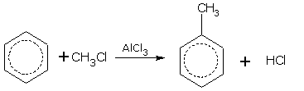
Substitution reactions benzene undergoes are:
Alkylation- substitution with an alkyl group
Toluene is so inexpensively produced industrially that it is not prepared in the laboratory. In principle it could be prepared by a variety of methods.
Benzene reacts with methyl chloride in presence of a Lewis acid such as aluminium chloride to give toluene:
A Lewis acid is an electron-pair acceptor.

Slide 70

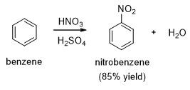
Halogenation- substitution with a halogen
FeCl₃ acts as a catalyst.
Nitration-substitution with a nitro group.
H₂SO₄ acts as a catalyst.

